Slide 1
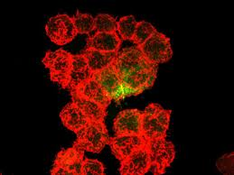
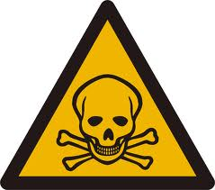
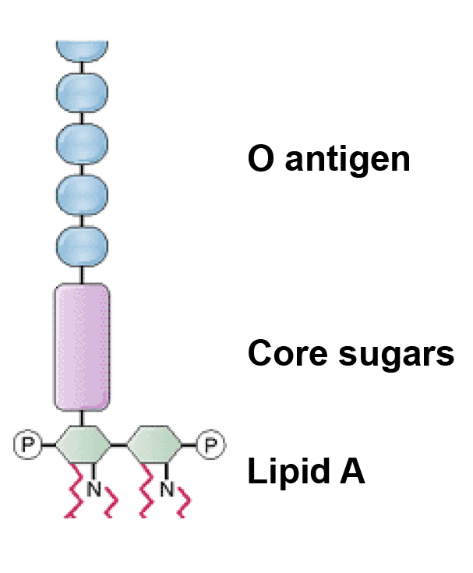
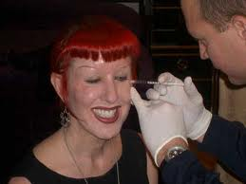
Infectious Diseases
Lesson 4.2

Slide 2
Lesson Objectives:
After finishing today’s lesson, you will be able to:
describe the symptoms of three diseases caused by bacteria that produce toxins.
describe how the bacteria in each disease use their toxins to make the host sick.

Slide 3
Do Now
Look at the next four images.
What is the common link between them?

Slide 4
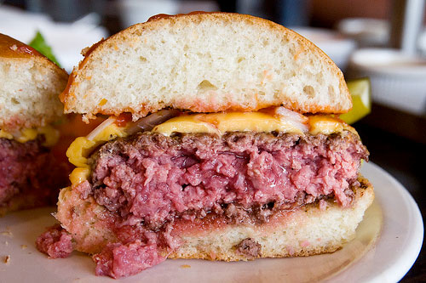

Slide 5
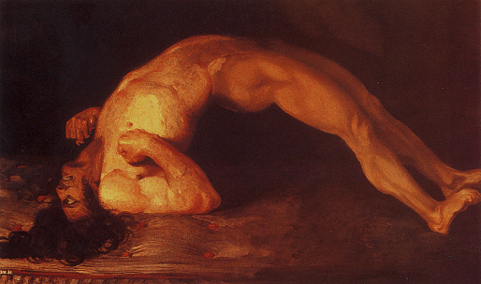

Slide 6
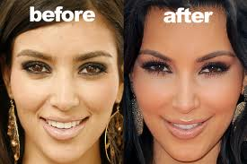

Slide 7
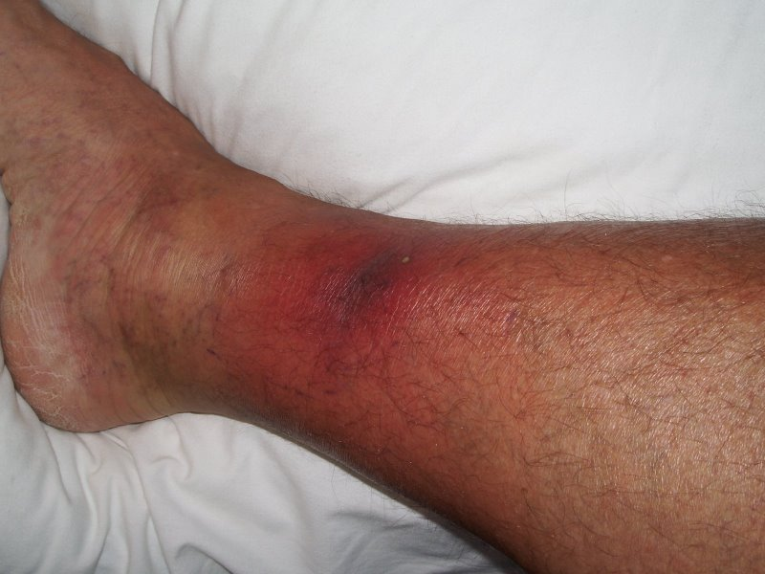

Slide 8
Thoughts?

Slide 9
All of the above diseases are caused by bacteria that have toxins!
What is a toxin?
How might bacteria use toxins?
How might using toxins help bacteria access nutrients?

Slide 10
Activity
Diseases discussed today: MRSA, gastroenteritis, botulism, bacterial meningitis, and tetanus.
In small groups, complete the table in the worksheet for your assigned disease topic.
You will then move to another table and teach them about your disease.
When the other students are teaching, fill in the rest of the table.

Slide 11
Wrap Up
Why are some pathogenic bacteria able to make toxins?

Slide 12
Homework
Complete the Jigsaw table in the worksheet.

